Slide 1



Spelling Correction: Edit Distance
Pawan Goyal
CSE, IITKGP
Week 2: Lecture 1
Spelling Correction: Edit Distance
Week 2: Lecture 1

Slide 2




Spelling Correction
I am writing this email on behaf of ...
The user typed ‘behaf’.
Which are some close words?
behalf
behave
....
Isolated word error correction
Pick the one that is closest to ‘behaf’
How to define ‘closest’? Need a distance metric
The simplest metric: edit distance
NPTEL
Spelling Correction: Edit Distance
Week 2: Lecture 1
2 / 20

Slide 3
Edit Distance
The minimum edit distance between two strings Is the minimum number of editing operations
◮ Insertion
◮ Deletion
◮ Substitution
NPTEL
Spelling Correction: Edit Distance
Week 2: Lecture 1
3 / 20

Slide 4

Minimum Edit Distance
Example
Edit distance from ‘intention’ to ‘execution’
NPTEL
Spelling Correction: Edit Distance
Week 2: Lecture 1
4 / 20

Slide 5
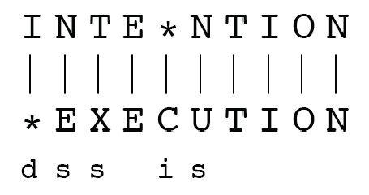
Minimum Edit Distance
NPTEL
If each operation has a cost of 1 (Levenshtein)
◮ Distance between these is 5
If substitution costs 2 (alternate version)
◮ Distance between these is 8
Spelling Correction: Edit Distance
Week 2: Lecture 1
5 / 20

Slide 6
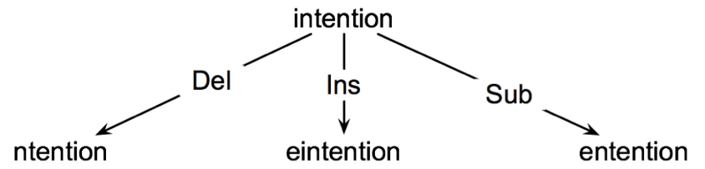
How to find the Minimum Edit Distance?
Searching for a path (sequence of edits) from the start string to the final string:
Initial state: the word we are transforming
Operators: insert, delete, substitute
Goal state: the word we are trying to get to
Path cost: what we want to minimize: the number of edits
NPTEL
Spelling Correction: Edit Distance
Week 2: Lecture 1
6 / 20

Slide 7
Minimum Edit as Search
How to navigate?
The space of all edit sequences is huge
Lot of distinct paths end up at the same state Don’t have to keep track of all of them
Keep track of the shortest path to each state
NPTEL
Spelling Correction: Edit Distance
Week 2: Lecture 1
7 / 20

Slide 8

Defining Minimum Edit Distance Matrix
For two strings
X of length n Y of length m
We define D(i, j)
the edit distance between X[1 .i] and Y[1 .j]
. .
i.e., the first i characters of X and the first j characters of Y
Thus, the edit distance between X and Y is D(n, m)
NPTEL
Spelling Correction: Edit Distance
Week 2: Lecture 1
8 / 20

Slide 9
Computing Minimum Edit Distance
Dynamic Programming
A tabular computation of D(n, m)
Solving problems by combining solutions to subproblems Bottom-up
◮ Compute D(i, j) for small i, j
◮ Compute larger D(i, j) based on previously computed smaller values
◮ Compute D(i, j) for all i and j till you get to D(n, m)
NPTEL
Spelling Correction: Edit Distance
Week 2: Lecture 1
9 / 20

Slide 10
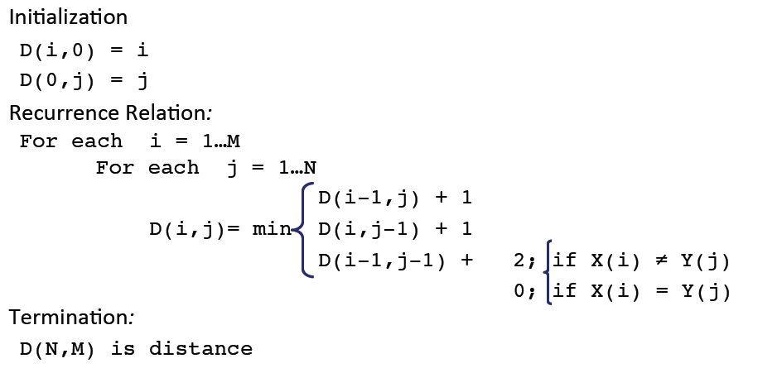
Dynamic Programming Algorithm
NPTEL
Spelling Correction: Edit Distance
Week 2: Lecture 1

Slide 11
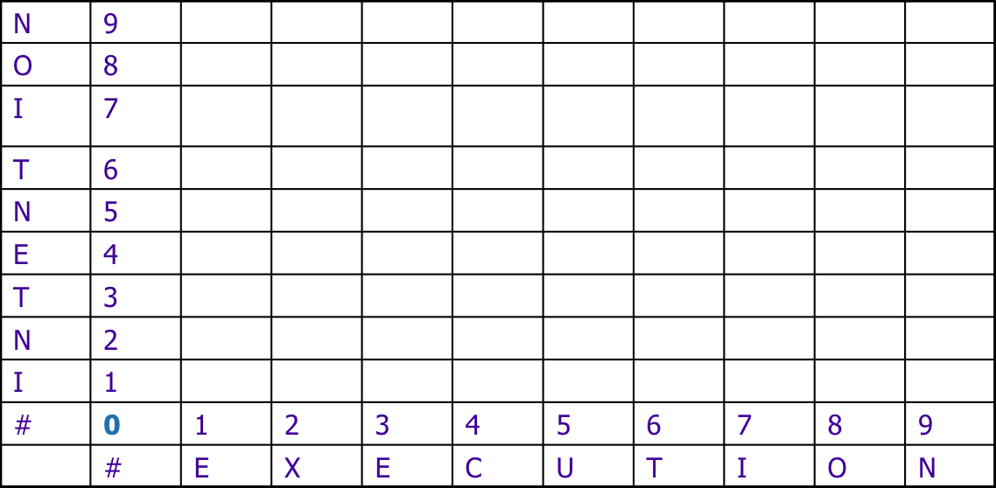
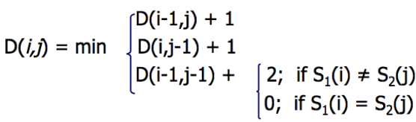
The Edit Distance Table
NPTEL
Spelling Correction: Edit Distance
Week 2: Lecture 1
11 / 20

Slide 12
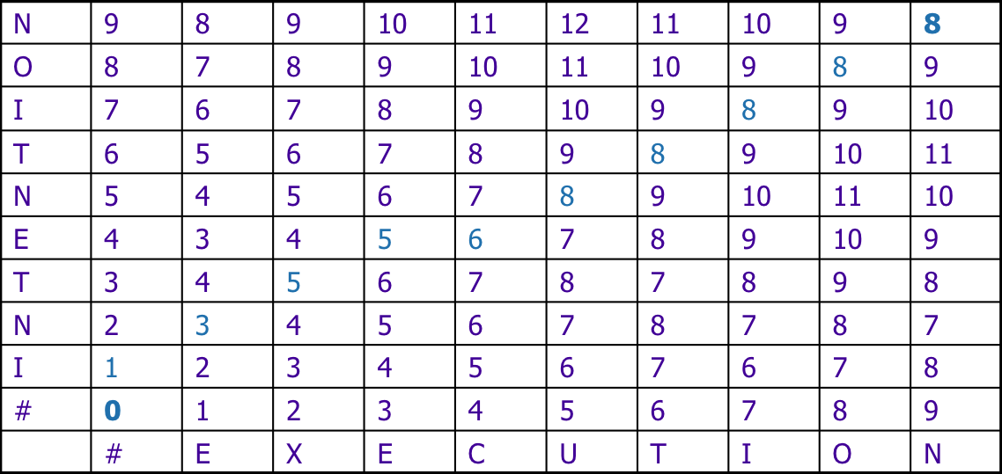
The Edit Distance Table
NPTEL
Spelling Correction: Edit Distance
Week 2: Lecture 1

Slide 13
Computing Alignments
Computing edit distance may not be sufficient for some applications
◮ We often need to align characters of the two strings to each other
We do this by keeping a “backtrace”
Every time we enter a cell, remember where we came from When we reach the end,
◮ Trace back the path from the upper right corner to read off the alignment
NPTEL
Spelling Correction: Edit Distance
Week 2: Lecture 1
13 / 20

Slide 14
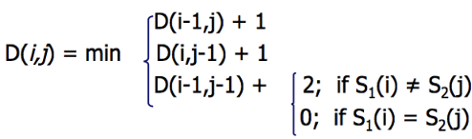
The Edit Distance Table
NPTEL
Spelling Correction: Edit Distance
Week 2: Lecture 1

Slide 15
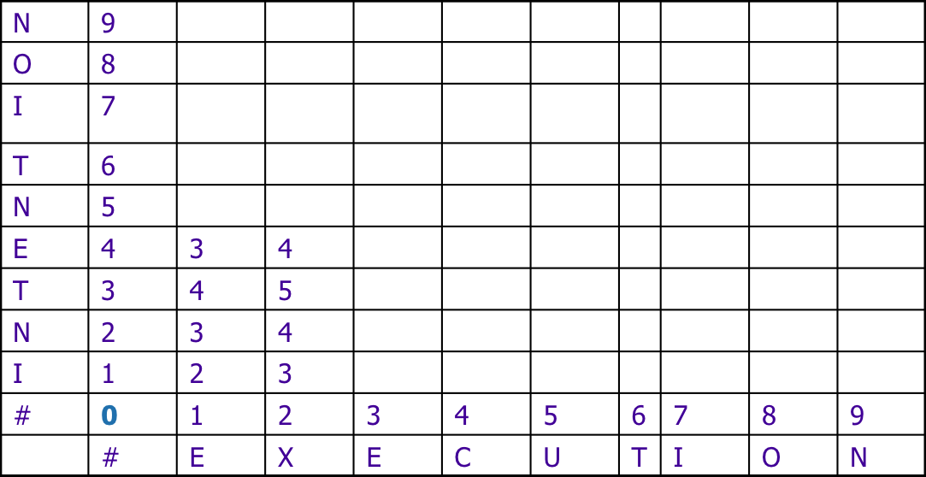
The Edit Distance Table
NPTEL
Spelling Correction: Edit Distance
Week 2: Lecture 1

Slide 16
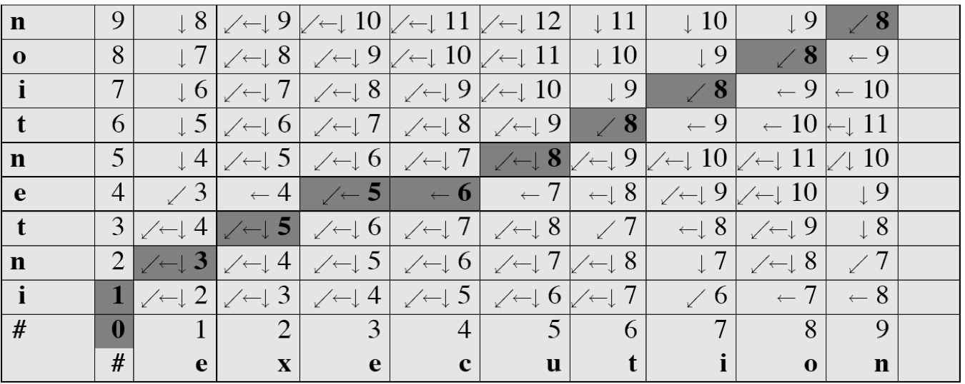
Minimum Edit with Backtrace
NPTEL
Spelling Correction: Edit Distance
Week 2: Lecture 1

Slide 17
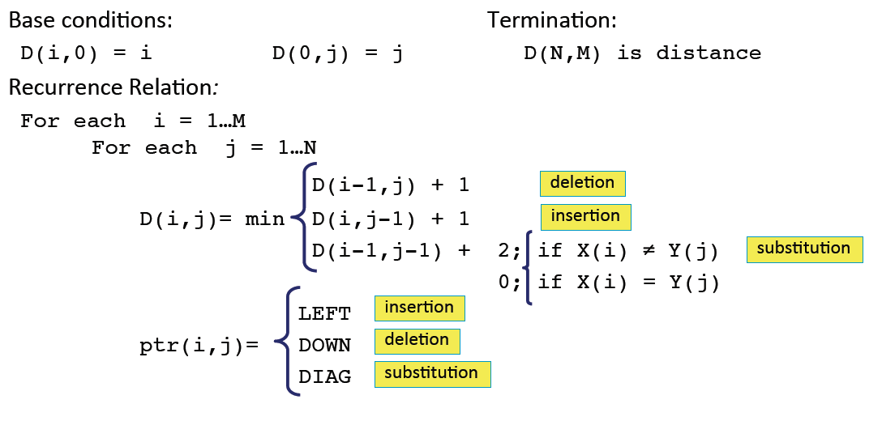
Adding Backtrace to Minimum Edit
NPTEL
Spelling Correction: Edit Distance
Week 2: Lecture 1

Slide 18
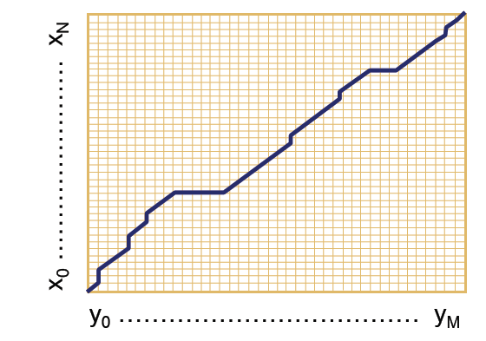
The distance matrix
Every non-decreasing path from (0,0) to (M,N) corresponds to an alignment of two sequences.
An optimal alignment is composed of optimal sub-alignments.
NPTEL
Spelling Correction: Edit Distance
Week 2: Lecture 1
18 / 20

Slide 19
Result of Backtrace
NPTEL
Spelling Correction: Edit Distance
Week 2: Lecture 1

Slide 20
Performance
Time O(nm)
Space O(nm)
Backtrace O(n + m)
NPTEL
Spelling Correction: Edit Distance
Week 2: Lecture 1
20 / 20

Slide 21
Weighted Edit Distance, Other variations
NPTEL
Pawan Goyal
CSE, IITKGP
Week 2: Lecture 2
Weighted Edit Distance, Other variations
Week 2: Lecture 2

Slide 22
Weighted Edit Distance
NPTEL
Why to add weights to the computation?
Some letters are more likely to be mistyped.
Weighted Edit Distance, Other variations
Week 2: Lecture 2

Slide 23
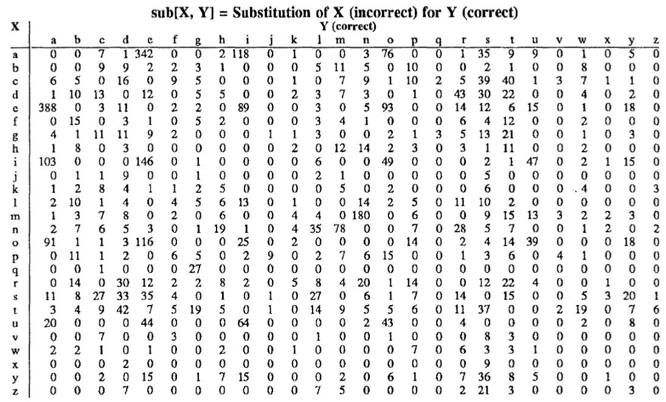
Confusion Matrix for Spelling Errors
NPTEL
Weighted Edit Distance, Other variations
Week 2: Lecture 2

Slide 24
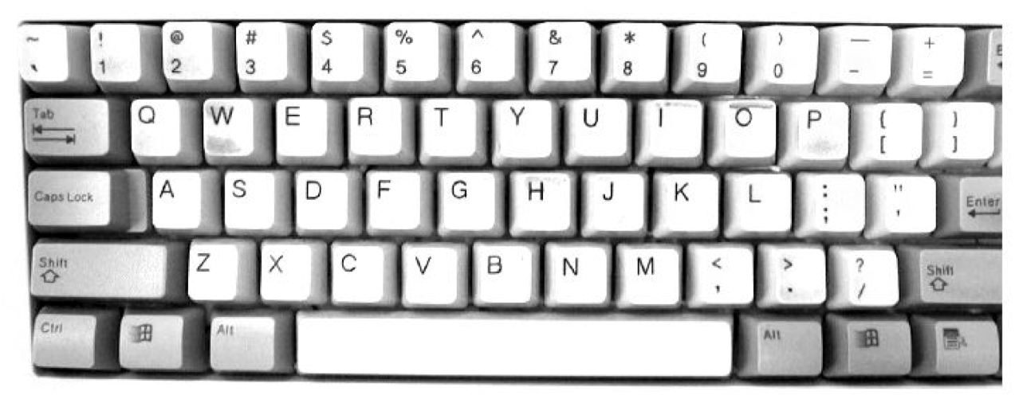
Keyboard Design
NPTEL
Weighted Edit Distance, Other variations
Week 2: Lecture 2

Slide 25
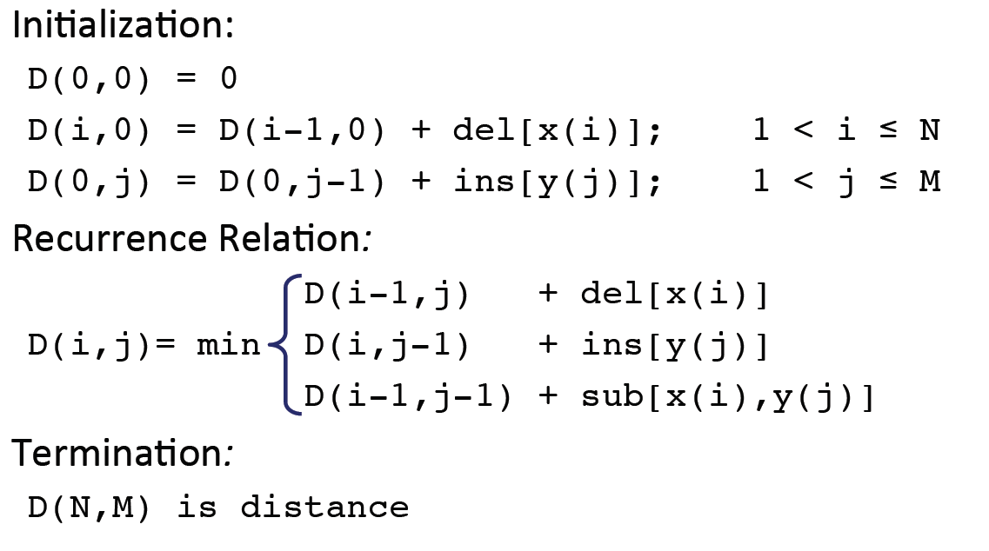
Weighted Minimum Edit Distance
NPTEL
Weighted Edit Distance, Other variations
Week 2: Lecture 2

Slide 26
How to modify the algorithm with transpose?
Transpose
transpose(x, y) = (y, x)
Also known as metathesis
Modification to the dynamic programmic algorithm
NPTEL
D(i − 1 j) + 1
,
(deletion) (insertion)

D(i, j − 1) + 1


(₁
if (x[i] 6= y[j])(substitution)

D[i][j] = min D(i − 1 j − 1)+
,
0 otherwise
(x[i] = y[j − 1] and x[i − 1] = y[j] (transposition)

D(i − 2 j − 2) + 1

,


Weighted Edit Distance, Other variations
Week 2: Lecture 2
6 / 12

Slide 27
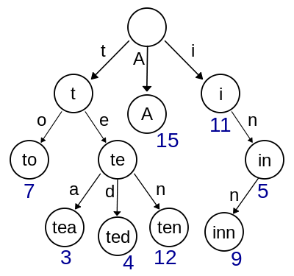
How to find dictionary entries with smallest edit distance?
Naïve Method
Compute edit ditance from the query term to each dictionary term – an exhaustive search
Can be made efficient if we do it over a trie structure
NPTEL
Weighted Edit Distance, Other variations
Week 2: Lecture 2
7 / 12

Slide 28
How to find dictionary entries with smallest edit distance?
Generate all possible terms with an edit distance <=2 (deletion + transpose + substitution + insertion) from the query term and search them in the dictionary.
For a word of length 9, alphabet of size 36, this will lead to 114,324 terms to search for
For Chinese alphabet size is 70,000 (Unicode Han Characters)
NPTEL
Weighted Edit Distance, Other variations
Week 2: Lecture 2
8 / 12

Slide 29
How to find dictionary entries with smallest edit distance?
Symmetric Delete Spelling Correction
Generate terms with an edit distance ≤ 2 (deletes) from each dictionary term (offline)
Generate terms with an edit distance ≤ 2 (deletes) from the input terms and search in dictionary
Number of deletes within edit distance ≤ 2 for a word of length 9 will be 45
A further check is required to remove the false positives
NPTEL
Weighted Edit Distance, Other variations
Week 2: Lecture 2
9 / 12

Slide 30

Spelling Correction
Types of spelling errors: Non-word Errors
behaf → behalf
Types of spelling errors: Real-word Errors
Typographical errors: three → there
Cognitive errors (homophones): piece → peace, too → two
NPTEL
Weighted Edit Distance, Other variations
Week 2: Lecture 2
10 / 12

Slide 31
Non-word spelling errors
Non-word spelling error detection
Any word not in a dictionary is an error The larger the dictionary the better
Non-word spelling error correction
Generate candidates: real words that are similar to the error word Choose the best one:
◮ Shortest weighted edit distance
◮ Highest noisy channel probabliity
NPTEL
Weighted Edit Distance, Other variations
Week 2: Lecture 2
11 / 12

Slide 32
Real word spelling errors
For each word w, generate candidate set
Find candidate words with similar pronunciations Find candidate words with similar spelling Include w in candidate set
Choosing best candidate
Noisy Channel
NPTEL
Weighted Edit Distance, Other variations
Week 2: Lecture 2
12 / 12

Slide 33
Noisy Channel Model for Spelling Correction
NPTEL
Pawan Goyal
CSE, IITKGP
Week 2: Lecture 3
Noisy Channel Model for Spelling Correction
Week 2: Lecture 3

Slide 34
Noisy Channel
We see an observation x of the misspelled word
Find the correct word w
wˆ = argmaxP(w|x)
w∈V
NPTEL
P(x|w)P(w)
= argmax
w∈V
P(x)
= argmaxP(x|w)P(w)
w∈V
Noisy Channel Model for Spelling Correction
Week 2: Lecture 3
2 / 17

Slide 35
Non-word spelling error: acress
Words with similar spelling
Small edit distance to error
Words with similar pronuncitation
Small edit distance of pronunciation to error
Damerau-Levenshtein edit distance Minimum edit distance, where edits are: Insertion, Deletion, Substitution, Transposition of two adjacent letters
NPTEL
Noisy Channel Model for Spelling Correction
Week 2: Lecture 3
3 / 17

Slide 36
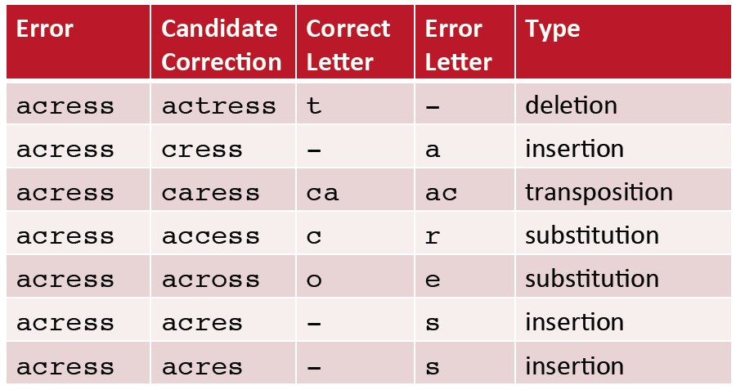
Words within edit distance 1 of acress
NPTEL
Noisy Channel Model for Spelling Correction
Week 2: Lecture 3

Slide 37

Candidate generation
80% of errors are within edit distance 1
Almost all errors within edit distance 2
Allow deletion of space or hyphen
thisidea → this idea inlaw → in-law
NPTEL
Noisy Channel Model for Spelling Correction
Week 2: Lecture 3
5 / 17

Slide 38
Computing error probability: confusion matrix
del[x,y]: count (xy typed as x) ins[x,y]: count (x typed as xy) sub[x,y]: count (x typed as y) trans[x,y]: count(xy typed as yx)
Insertion and deletion are conditioned on previous character
NPTEL
Noisy Channel Model for Spelling Correction
Week 2: Lecture 3
6 / 17

Slide 39
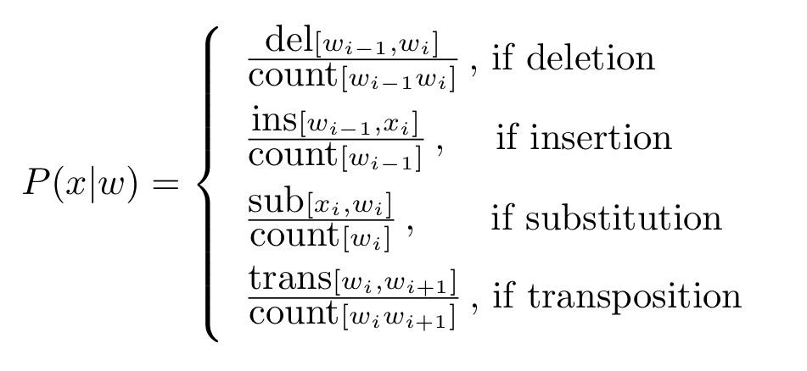
Channel model
NPTEL
Noisy Channel Model for Spelling Correction
Week 2: Lecture 3
10 / 17

Slide 40
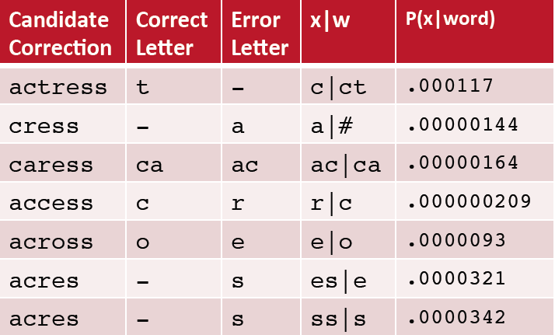
Channel model for acress
NPTEL
Noisy Channel Model for Spelling Correction
Week 2: Lecture 3
10 / 17

Slide 41
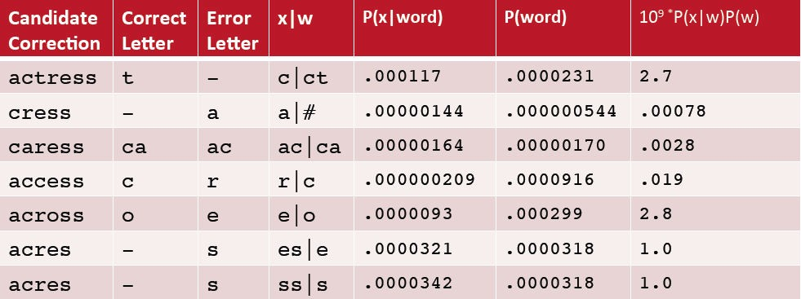
Noisy channel probability for acress
NPTEL
Noisy Channel Model for Spelling Correction
Week 2: Lecture 3
10 / 17

Slide 42
Using a bigram language model
“ ... versatile acress whose ...”
Counts from the Corpus of Contemporary American English with add-1 smoothing
P(actress|versatile) = 0.000021, P(across|versatile) = 0.000021
P(whose|actress) = 0.0010, P(whose|across) = 0.000006
P(“versatile actress whose”) = 0.000021 * 0.0010 = 210 x 10⁻¹⁰
P(“versatile across whose”) = 0.000021 * 0.000006 = 1 x10⁻¹⁰
NPTEL
Noisy Channel Model for Spelling Correction
Week 2: Lecture 3
10 / 17

Slide 43
Real-word spelling errors
The study was conducted mainly be John Black The design an construction of the system ...
25-40% of spelling errors are real words
NPTEL
Noisy Channel Model for Spelling Correction
Week 2: Lecture 3
11 / 17

Slide 44
Noisy channel for real-word spell correction
Given a sentence X = w₁, w₂, w₃ . . . , w_{n} Candidate (w₁) = {w₁, w′₁, w′′₁, w′′′₁, . . .} Candidate (w₂) = {w₂, w′₂, w′′₂, w′′′₂, . . .} Candidate (w₃) = {w₃, w′₃, w′′₃, w′′′₃, . . .}
NPTEL
Choose the sequence W that maximizes P(W|X)
Noisy Channel Model for Spelling Correction
Week 2: Lecture 3
12 / 17

Slide 45
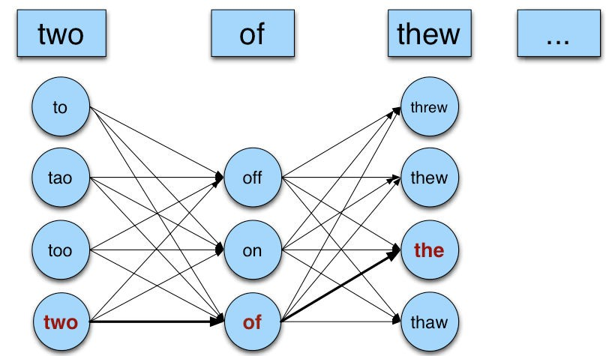
Noisy channel for real-world spell correction
NPTEL
Noisy Channel Model for Spelling Correction
Week 2: Lecture 3

Slide 46
Simplification: One error per sentence
Choose among all possible sentences with one word replaced
two of thew
w₁, w′′₂, w₃ two off thew w₁, w₂, w′₃ two of the w′′′₁, w₂, w₃ too of thew
Choose the sequence W that maximizes P(W|X)
NPTEL
Noisy Channel Model for Spelling Correction
Week 2: Lecture 3
14 / 17

Slide 47
Getting the probability values
Noisy Channel
W^{ˆ} = argmaxP(W|X)
W∈S
where X is the observed sentence and S is the set of all the possible sequences from the candidate set
= argmaxP(X|W)P(W)
W∈S
P(X|W)
Same as for non-word spelling correction Also require proabability for no error P(w|w)
NPTEL
Noisy Channel Model for Spelling Correction
Week 2: Lecture 3
15 / 17

Slide 48
Probability of no error
What is the probability for a correctly typed word? P(“the”|“the”)
It may depend on the source text under consideration
1 error in 10 words → 0.9
1 error in 100 words → 0.99
NPTEL
Noisy Channel Model for Spelling Correction
Week 2: Lecture 3
16 / 17

Slide 49
Computing P(W)
Use Language Model
Unigram Bigram
...
NPTEL
Noisy Channel Model for Spelling Correction
Week 2: Lecture 3
17 / 17

Slide 50
N-gram Language Models
NPTEL
Pawan Goyal
CSE, IITKGP
Week 2: Lecture 4
N-gram Language Models
Week 2: Lecture 4

Slide 51
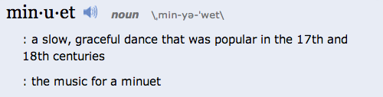
Context Sensitive Spelling Correction
The office is about fifteen minuets from my house
NPTEL
Use a Language Model
P(about fifteen minutes from) > P(about fifteen minuets from)
N-gram Language Models
Week 2: Lecture 4
2 / 24

Slide 52

Probablilistic Language Models: Applications
Speech Recognition
P(I saw a van) >> P(eyes awe of an)
Machine Translation
Which sentence is more plausible in the target language?
P(high winds) > P(large winds)
Other Applications
Context Sensitive Spelling Correction Natural Language Generation
...
NPTEL
N-gram Language Models
Week 2: Lecture 4
3 / 24

Slide 53
Completion Prediction
Language model also supports predicting the completion of a sentence.
◮ Please turn off your cell ...
◮ Your program does not ...
Predictive text input systems can guess what you are typing and give choices on how to complete it.
NPTEL
N-gram Language Models
Week 2: Lecture 4
4 / 24

Slide 54
Probabilistic Language Modeling
Goal: Compute the probability of a sentence or sequence of words:
P(W) = P(w₁, w₂, w₃,..., w_{n})
Related Task: probability of an upcoming word:
P(w₄|w₁, w₂, w₃)
A model that computes either of these is called a language model
NPTEL
N-gram Language Models
Week 2: Lecture 4
5 / 24

Slide 55
Computing P(W)
How to compute the joint probability
P(about, fifteen, minutes, from)
Basic Idea
Rely on the Chain Rule of Probability
NPTEL
N-gram Language Models
Week 2: Lecture 4
6 / 24

Slide 56
The Chain Rule
Conditional Probabilities
P(A, B)
P(B|A) =
P(A)
NPTEL
P(A, B) = P(A)P(B|A)
More Variables
P(A, B, C, D) = P(A)P(B|A)P(C|A, B)P(D|A, B, C)
The Chain Rule in General
P(x₁, x₂, . . . , x_{n}) = P(x₁)P(x₂|x₁)P(x₃|x₁, x₂)... P(x_{n}|x₁,..., x_{n−1})
N-gram Language Models
Week 2: Lecture 4
7 / 24

Slide 57
Probability of words in sentences
P(w₁w₂ . . . w_{n}) = ∏P(w_{i}|w₁w₂ . . . w_{i−1})
i
P(“about fifteen minutes from”) =
P(about) x P(fifteen | about) x P(minutes | about fifteen) x P(from | about fifteen minutes)
NPTEL
N-gram Language Models
Week 2: Lecture 4
8 / 24

Slide 58
Estimating These Probability Values
Count and divide
NPTEL
P(office | about fifteen minutes from) = Count (about fifteen minutes from office)
Count (about fifteen minutes from)
What is the problem
We may never see enough data for estimating these
N-gram Language Models
Week 2: Lecture 4
9 / 24

Slide 59
Markov Assumption
Simplifying Assumption: Use only the previous word
P(office | about fifteen minutes from) ≈ P(office | from)
Or the couple previous words
P(office | about fifteen minutes from) ≈ P(office | minutes from)
NPTEL
N-gram Language Models
Week 2: Lecture 4
10 / 24

Slide 60
Markov Assumption
More Formally: kth order Markov Model
Chain Rule:
P(w₁w₂ . . . w_{n}) = ∏P(w_{i}|w₁w₂ . . . w_{i−1})
i
Using Markov Assumption: only k previous words
P(w₁w₂ . . . w_{n}) ≈ ∏P(w_{i}|w_{i−k} . . . w_{i−1})
i
We approximate each component in the product
P(w_{i}|w₁w₂ . . . w_{i−1}) ≈ P(w_{i}|w_{i−k} . . . w_{i−1})
NPTEL
N-gram Language Models
Week 2: Lecture 4
11 / 24

Slide 61
N-Gram Models
P(office | about fifteen minutes from)
An N-gram model uses only N − 1 words of prior context.
NPTEL
N-gram Language Models
Week 2: Lecture 4
12 / 24

